Slide 1


Slide 2

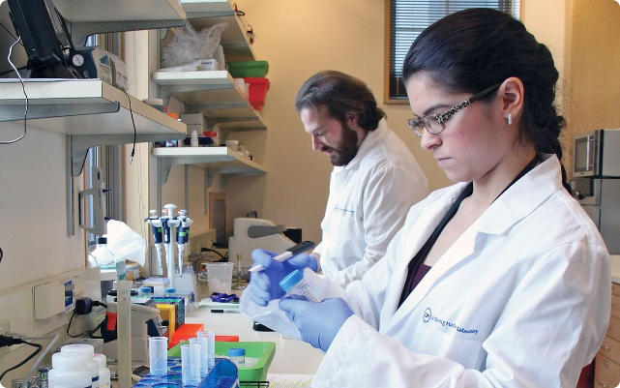
Breast Cancer Prediction Project
This project aims to develop an accurate machine learning model to predict breast cancer based on various patient data features. The goal is to assist healthcare professionals in early detection and diagnosis, ultimately improving patient outcomes.
Presented by Taha Saddiqui

Slide 3


Introduction and Objective
1
Introduction
2
Objective
Breast cancer is a leading cause of cancer-related deaths among women worldwide. Early detection is crucial for effective treatment and improving survival rates.
To build a machine learning model that can accurately predict the presence of breast cancer based on patient data, enabling early intervention and better patient outcomes.

Slide 4

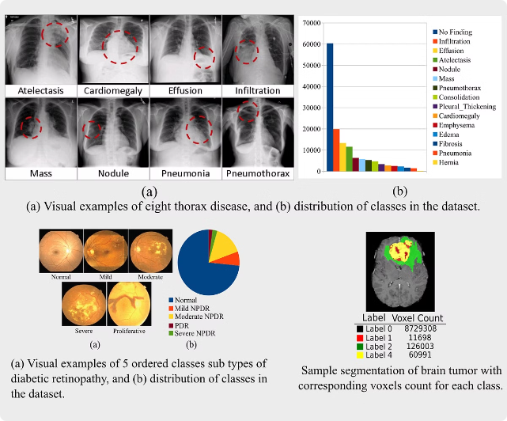
Dataset Overview
Features
The dataset includes various patient information such as age, tumor size, and lymph node status.
Data Cleanliness
Target Variable
The dataset is well-curated, with no missing values or obvious outliers, ensuring reliable model training and evaluation.
The target variable is a binary classification, indicating the presence or absence of breast cancer.

Slide 5

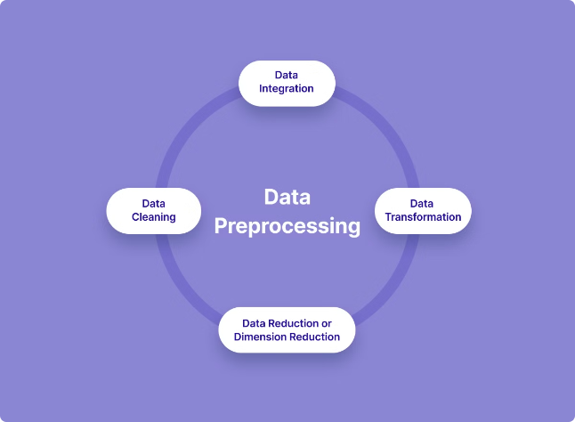
Feature Engineering and Preprocessing
1
Feature Selection
Identifying the most relevant features that contribute to the prediction of breast cancer.
2
Data Scaling
Ensuring all features are on a similar scale to avoid biases in the model training process.
3
Train-Test Split
Dividing the dataset into training and testing sets for model evaluation and performance assessment.

Slide 6

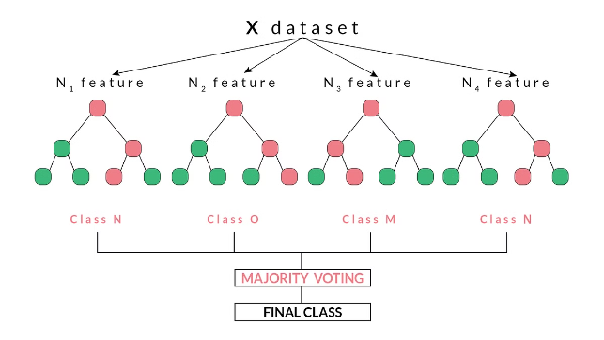
Random Forest Model
Model Overview
Hyperparameter Tuning
The Random Forest model is an ensemble learning method that combines multiple decision trees to improve the accuracy and robustness of the predictions.
Optimizing the model's parameters, such as the number of trees and the maximum depth, to achieve the best performance.
Feature Importance
Performance Metrics
Identifying the most influential features that contribute to the model's decision-making process.
Evaluating the model's accuracy, precision, recall, and F1-score on the test set.

Slide 7


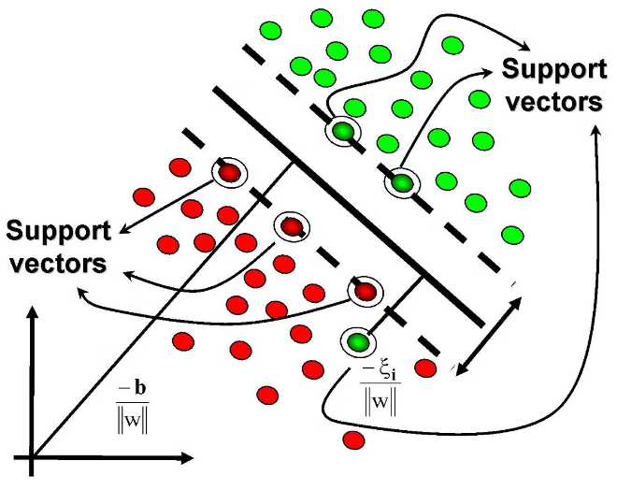


Support Vector Machine (SVM) Model
Kernel Selection
Choosing the appropriate kernel function (e.g., linear, polynomial, or radial basis function) to map the data into a higher-dimensional space.
Hyperparameter Tuning
Optimizing the model's parameters, such as the regularization parameter and the gamma value, to achieve the best performance.
Performance Evaluation
Assessing the model's accuracy, precision, recall, and F1-score on the test set.

Slide 8


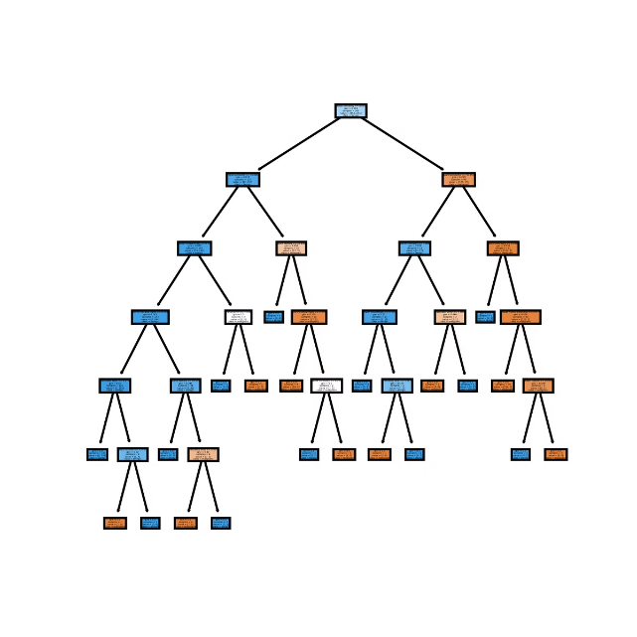


Decision Tree Model
Model Building
Constructing a decision tree-based model to predict the presence or absence of breast cancer.
Pruning
Optimizing the decision tree's structure to avoid overfitting and improve generalization.
Performance Assessment
Evaluating the model's accuracy, precision, recall, and F1-score on the test set.

Slide 9

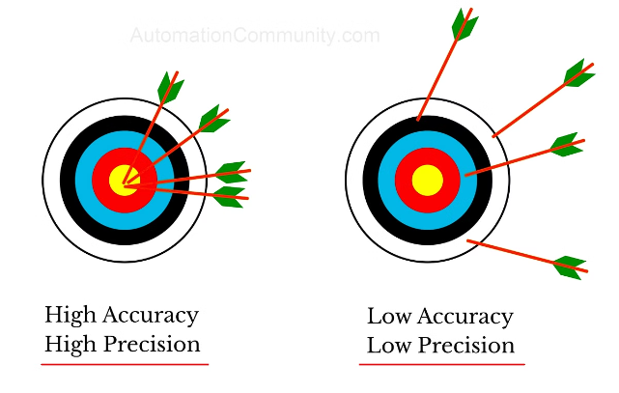
Accuracy Comparison
Model
Accuracy
Random Forest
94.74%
Support Vector Machine (SVM)
94.74%
Decision Tree
90.35%

Slide 10


Random Forest and SVM Achieve 94.74% Accuracy
1
High Predictive Performance
2
Potential Clinical Impact
The Random Forest and SVM models achieved an impressive 94.74% accuracy in predicting breast cancer, demonstrating their effectiveness in this task.
These highly accurate models can significantly contribute to early detection and diagnosis, ultimately improving patient outcomes and reducing the burden of breast cancer.

Slide 11

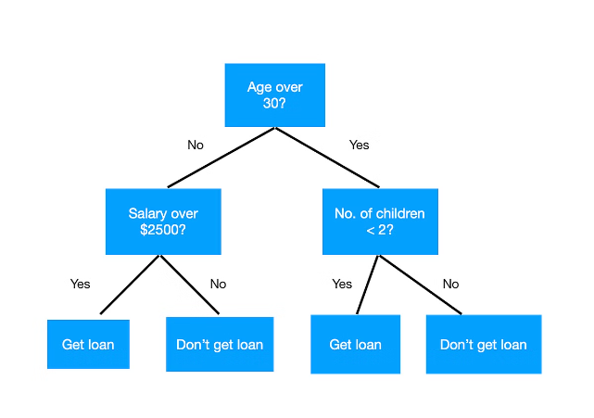
Decision Tree Achieves 90.35% Accuracy
Slightly Lower Performance
Potential Improvements
While the Decision Tree model performed well with a 90.35% accuracy, it fell short compared to the Random Forest and SVM models.
Further tuning of the Decision Tree model, such as adjusting the tree depth or implementing ensemble techniques, could potentially improve its performance.

Slide 12

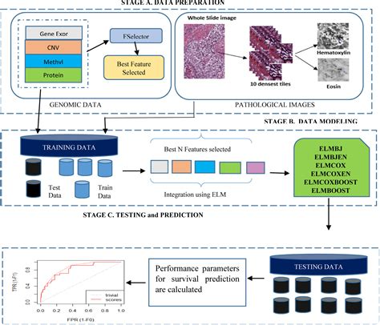
Conclusion and Summary
In this breast cancer prediction project, we developed and evaluated several machine learning models, including Random Forest, SVM, and Decision Tree. The Random Forest and SVM models achieved the highest accuracy of 94.74%, demonstrating their strong predictive power and ability to generalize well to new data. The Decision Tree model, while slightly lower at 90.35% accuracy, still provides a solid baseline and offers the advantage of interpretability. Overall, this project showcases the effectiveness of machine learning in tackling complex medical challenges like breast cancer diagnosis.

Slide 13

Thanks!
Do you have any questions?
baib232005@myu.edu.pk

